Slide 1
Unit 3: Systems
On Level

Slide 2
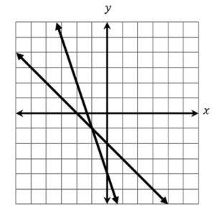

9/23 SAT Bell Work
What coordinate represents the solution to the system of equations below?
Notes:
x

Slide 3
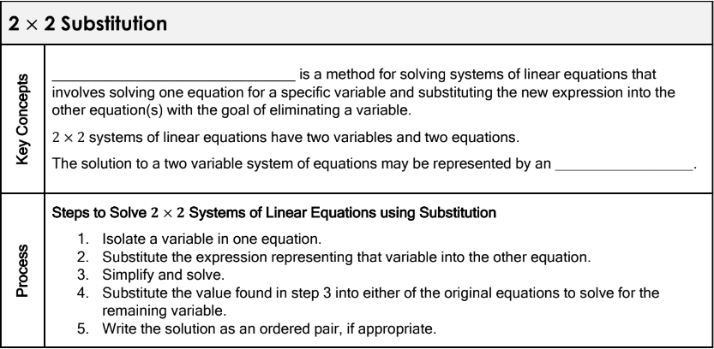
3.1: 2 Linear Equations with 2 Variables
Learning Objective: I will be able to solve 2 linear equations with 2 variables.

Slide 4
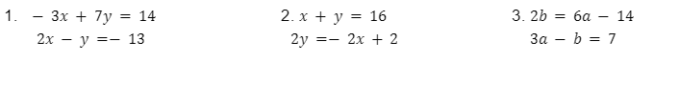
3.1: 2 Linear Equations with 2 Variables
Learning Objective: I will be able to solve 2 linear equations with 2 variables.

Slide 5
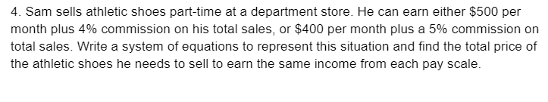
3.1: 2 Linear Equations with 2 Variables
Learning Objective: I will be able to solve 2 linear equations with 2 variables.

Slide 6
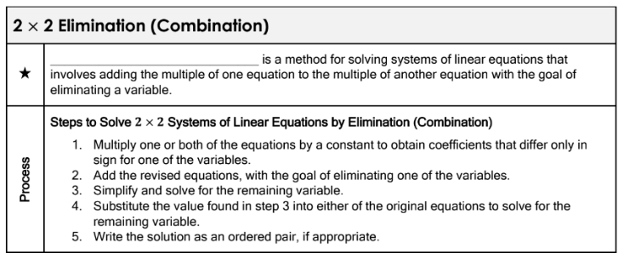
3.1: 2 Linear Equations with 2 Variables
Learning Objective: I will be able to solve 2 linear equations with 2 variables.

Slide 7
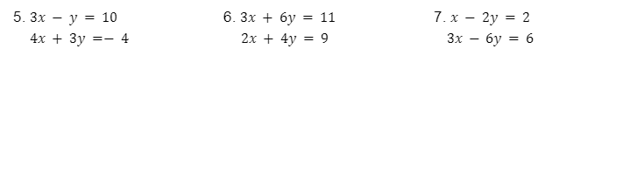
3.1: 2 Linear Equations with 2 Variables
Learning Objective: I will be able to solve 2 linear equations with 2 variables.

Slide 8
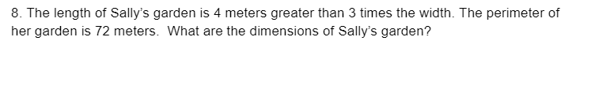
3.1: 2 Linear Equations with 2 Variables
Learning Objective: I will be able to solve 2 linear equations with 2 variables.

Slide 9
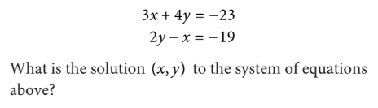

9/24 SAT Bell Work
Notes:
x

Slide 10
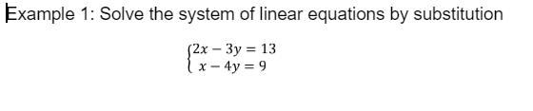
3.2: Solving By Substitution Day 1
Learning Objective: I will be able to solve 3 linear equations with 3 variables by substitution.

Slide 11
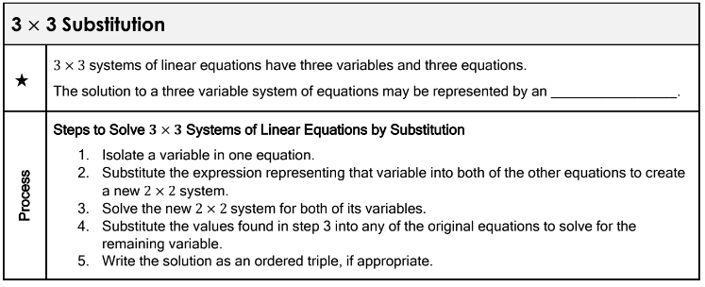
3.2: Solving By Substitution Day 1
Learning Objective: I will be able to solve 3 linear equations with 3 variables by substitution.

Slide 12
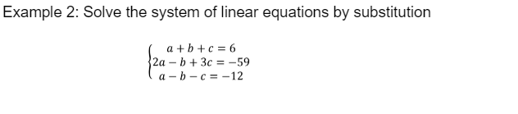
3.2: Solving By Substitution Day 1
Learning Objective: I will be able to solve 3 linear equations with 3 variables by substitution.

Slide 13
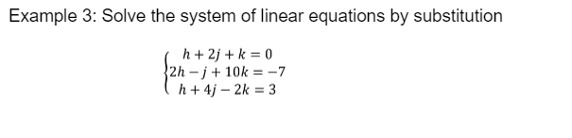
3.2: Solving By Substitution Day 1
Learning Objective: I will be able to solve 3 linear equations with 3 variables by substitution.

Slide 14
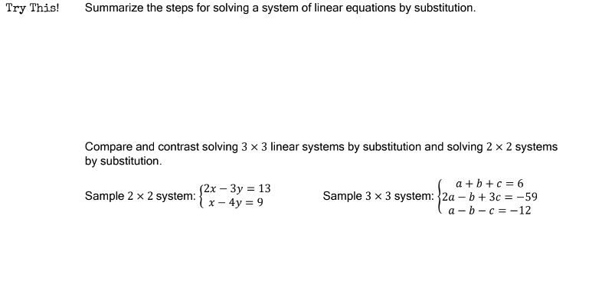
3.2: Solving By Substitution Day 1
Learning Objective: I will be able to solve 3 linear equations with 3 variables by substitution.

Slide 15
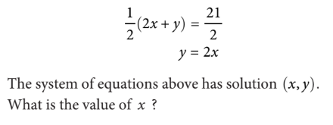

9/26 SAT Bell Work

Slide 16
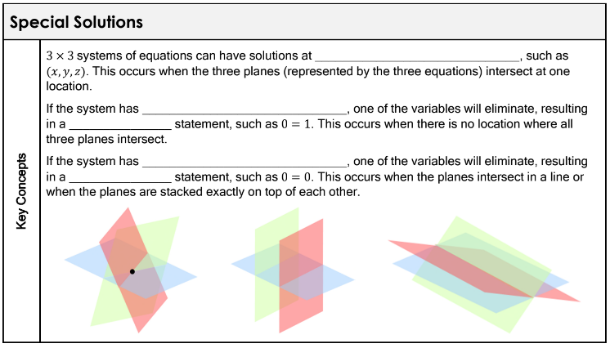
3.2: Solving By Substitution Day 2
Learning Objective: I will be able to solve 3 linear equations with 3 variables by substitution.

Slide 17
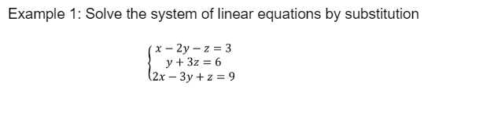
3.2: Solving By Substitution Day 2
Learning Objective: I will be able to solve 3 linear equations with 3 variables by substitution.

Slide 18
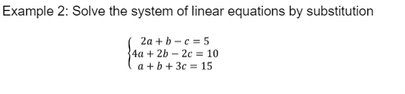
3.2: Solving By Substitution Day 2
Learning Objective: I will be able to solve 3 linear equations with 3 variables by substitution.

Slide 19
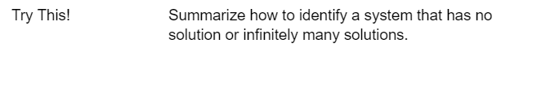
3.2: Solving By Substitution Day 2
Learning Objective: I will be able to solve 3 linear equations with 3 variables by substitution.

Slide 20
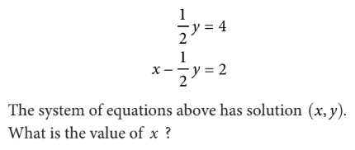

9/27 SAT Bell Work

Slide 21
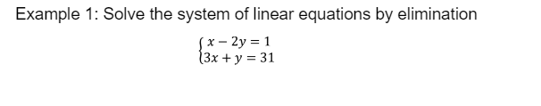
3.3: Solving By Elimination Day 1
Learning Objective: I will be able to solve 3 linear equations with 3 variables by elimination.

Slide 22
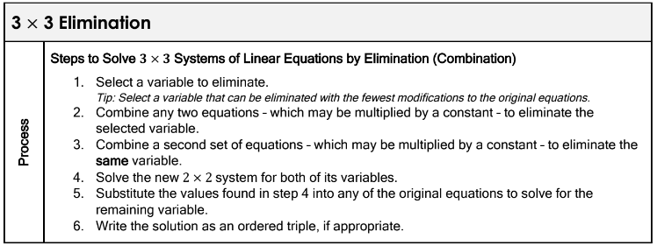
3.3: Solving By Elimination Day 1
Learning Objective: I will be able to solve 3 linear equations with 3 variables by elimination.

Slide 23
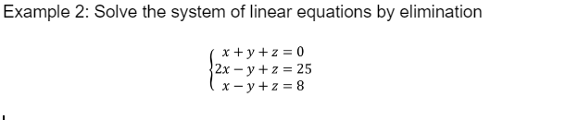
3.3: Solving By Elimination Day 1
Learning Objective: I will be able to solve 3 linear equations with 3 variables by elimination.

Slide 24
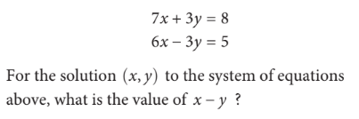


9/30 SAT Bell Work

Slide 25
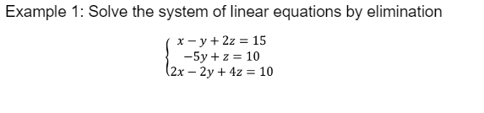
3.3: Solving By Elimination Day 2
Learning Objective: I will be able to solve 3 linear equations with 3 variables by elimination.

Slide 26
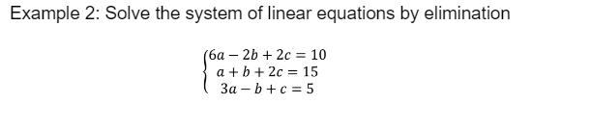
3.3: Solving By Elimination Day 2
Learning Objective: I will be able to solve 3 linear equations with 3 variables by elimination.

Slide 27
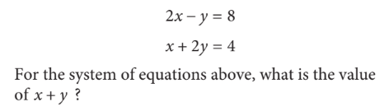

10/1 SAT Bell Work

Slide 28
Solving Practice
Learning Objective: I will be able to solve 3 linear equations with 3 variables.
Work on the practice if you finish work on IXL.

Slide 29
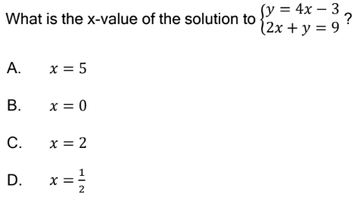

10/2 SAT Bell Work

Slide 30
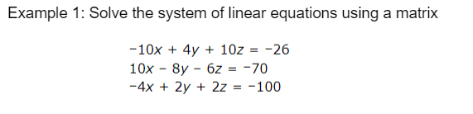
3.4: Solving By Matrix
Learning Objective: I will be able to solve 3 linear equations with 3 variables using matrices.

Slide 31
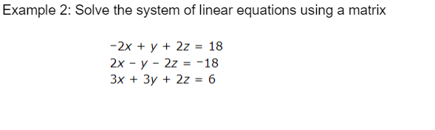
3.4: Solving By Matrix
Learning Objective: I will be able to solve 3 linear equations with 3 variables using matrices.

Slide 32
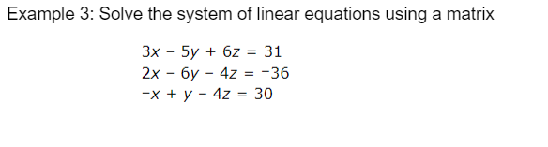
3.4: Solving By Matrix
Learning Objective: I will be able to solve 3 linear equations with 3 variables using matrices.

Slide 33
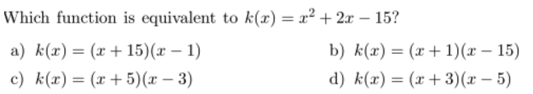
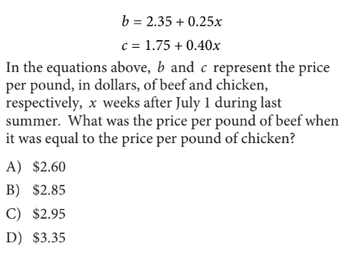
10/3 SAT Bell Work

Slide 34

3.5: Applications
Learning Objective: I will be able to solve 3 linear equations with 3 variables in real world situations.

Slide 35
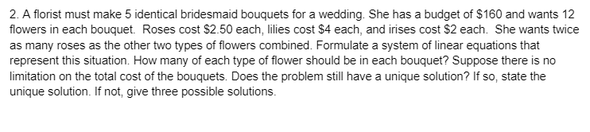
3.5: Applications
Learning Objective: I will be able to solve 3 linear equations with 3 variables in real world situations.

Slide 36
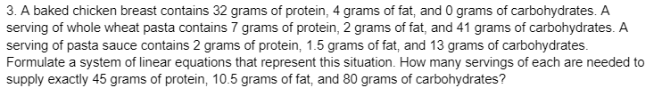
3.5: Applications
Learning Objective: I will be able to solve 3 linear equations with 3 variables in real world situations.

Slide 37

3.5: Applications
Learning Objective: I will be able to solve 3 linear equations with 3 variables in real world situations.

Slide 38
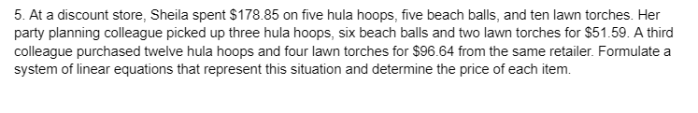
3.5: Applications
Learning Objective: I will be able to solve 3 linear equations with 3 variables in real world situations.

Slide 39

3.5: Applications
Learning Objective: I will be able to solve 3 linear equations with 3 variables in real world situations.

Slide 40
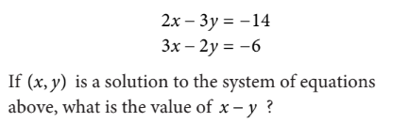
10/4 SAT Bell Work

Slide 41
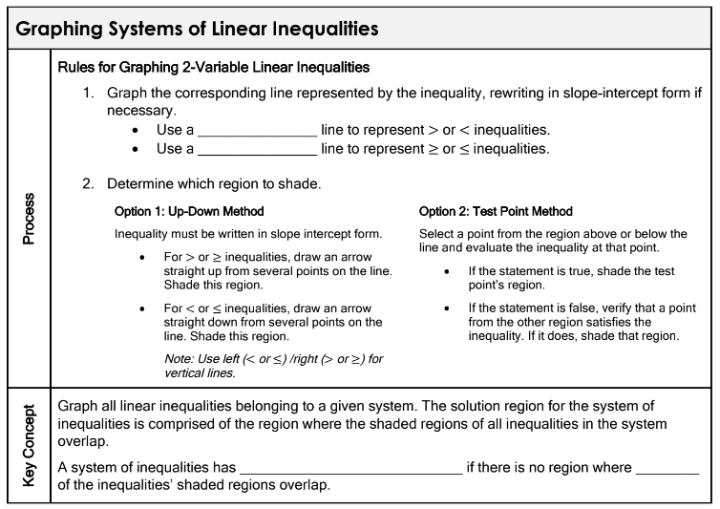
3.6: Linear Inequalities
Learning Objective: I will be able to solve systems of linear inequalities.

Slide 42
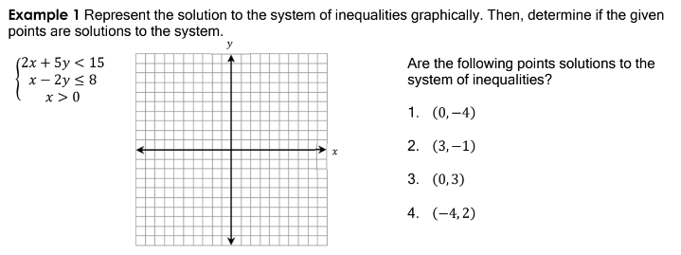
3.6: Linear Inequalities
Learning Objective: I will be able to solve systems of linear inequalities.

Slide 43
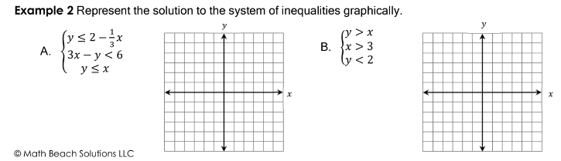
3.6: Linear Inequalities
Learning Objective: I will be able to solve systems of linear inequalities.

Slide 44
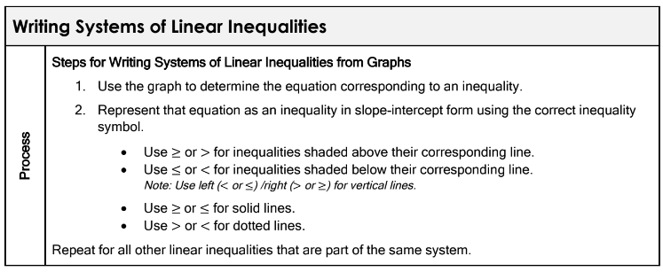
3.6: Linear Inequalities
Learning Objective: I will be able to solve systems of linear inequalities.

Slide 45
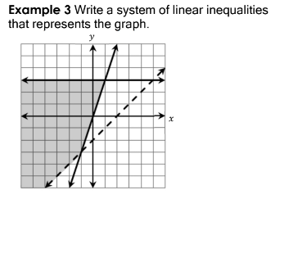
3.6: Linear Inequalities
Learning Objective: I will be able to solve systems of linear inequalities.

Slide 46
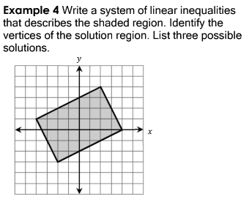
3.6: Linear Inequalities
Learning Objective: I will be able to solve systems of linear inequalities.

Slide 47
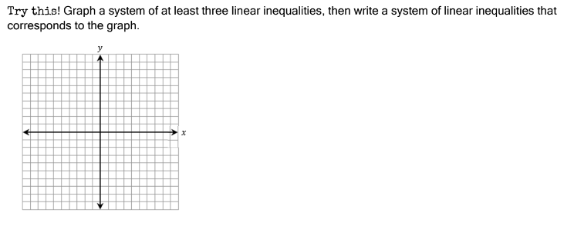
3.6: Linear Inequalities
Learning Objective: I will be able to solve systems of linear inequalities.

